Slide 1



PELOTON’s Post Pandemic Pivot
A Strategic Analysis of Growth, Retention, and Market Position
Contributors:
Aljoharah Algwaiz, Celine Widjaja, Ellen Li, Helena Bardsley, Michael Yan, Samantha Yung, Yi Chen

Slide 2
In just two years, Peloton went from a
$1.3 billion revenue peak to facing significant market challenges.

Slide 3

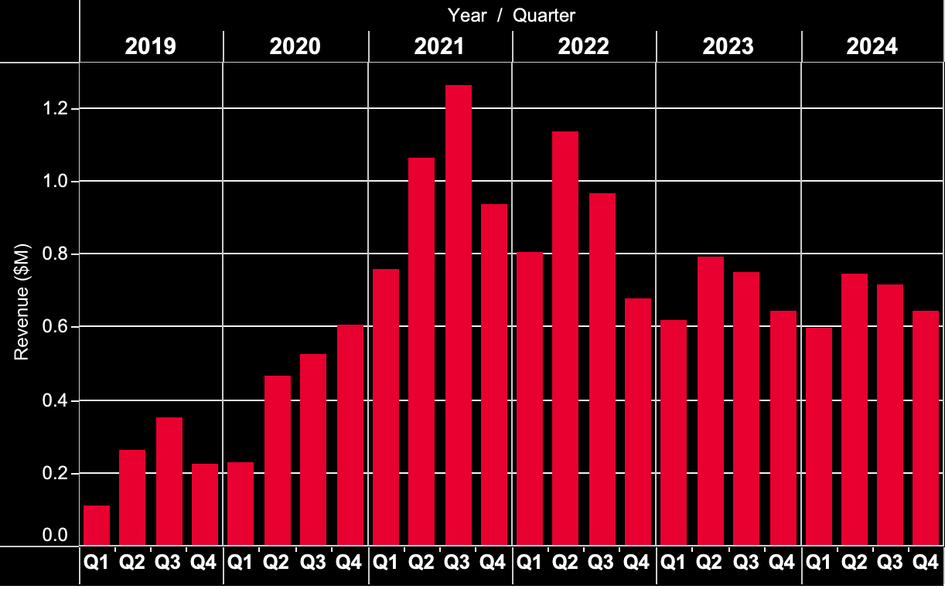
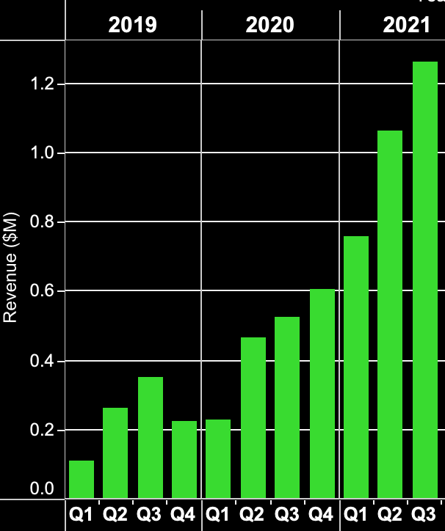
COVID-19 and Peloton’s Rising Popularity
Peak revenue of $1.3B in Q2 2021
322% revenue growth during the pandemic

Slide 4
Post-Pandemic Reality
32% decrease in Revenue

Slide 5

3 Key Questions
Have we misread the post-pandemic fitness landscape entirely?
Do we truly understand what our market wants?
How strong is our competitive advantage really?

Slide 6
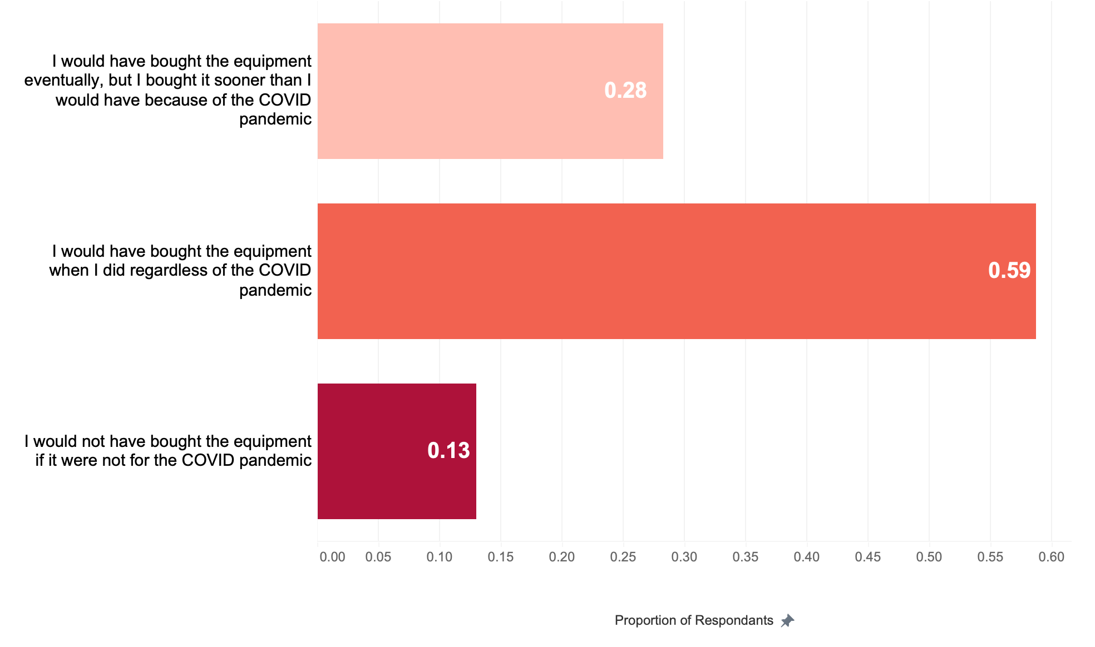
Company survey suggests that COVID-19 was not the only factor that affected customers’ buying decisions.

Slide 7


What Do Customers Like and Dislike about Peloton?
Good Value for Money
14%
Time to Deliver
9%
Negative Press
31%
Lack of Space
12%
Live Classes
12%
Safety
5%
Best Exercise Equipment
34%
Best Instructors
9%
On-Demand Classes
8%
Price
65%
Convenience
16%
Community
7%
Other
9%
* Participants were allowed to provide multiple answers

Slide 8




Key Post-Pandemic Trends in the Fitness Industry
85%
60%
25%
71%
Return to Traditional Gyms
Hybrid Fitness Model
Rise of Boutique Fitness
Shifting Customer Loyalty
of gym-goers returned to in-person workouts.
of Americans prefer a mix of digital and in-person workouts.
YoY growth in boutique fitness studios. Consumers seek specialized community-driven experiences.
of fitness service customers use multiple services and prefer flexible, no-commitment options

Slide 9
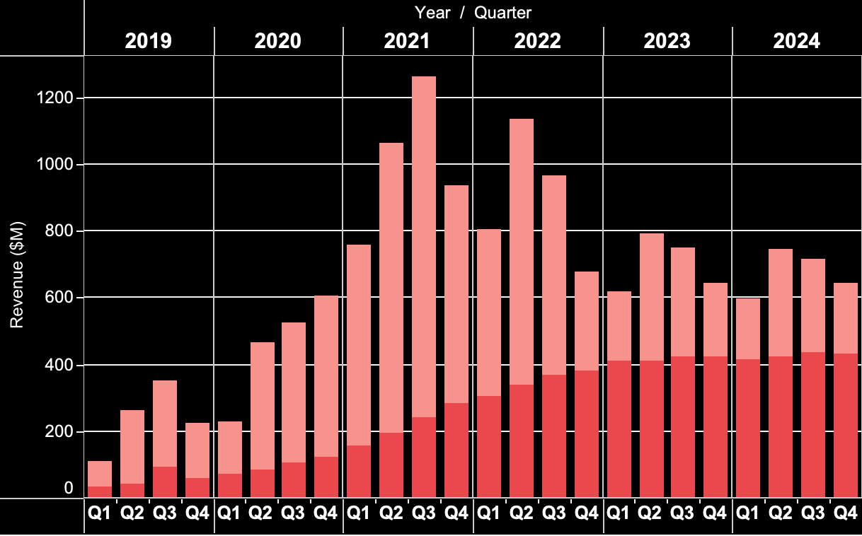

The Revenue Gap
Fitness Equipment
Subscription
While subscription revenue remained stable, there is a gradual decline in equipment sales as covid restrictions subsided that led to Peloton's overall revenue decrease.

Slide 10
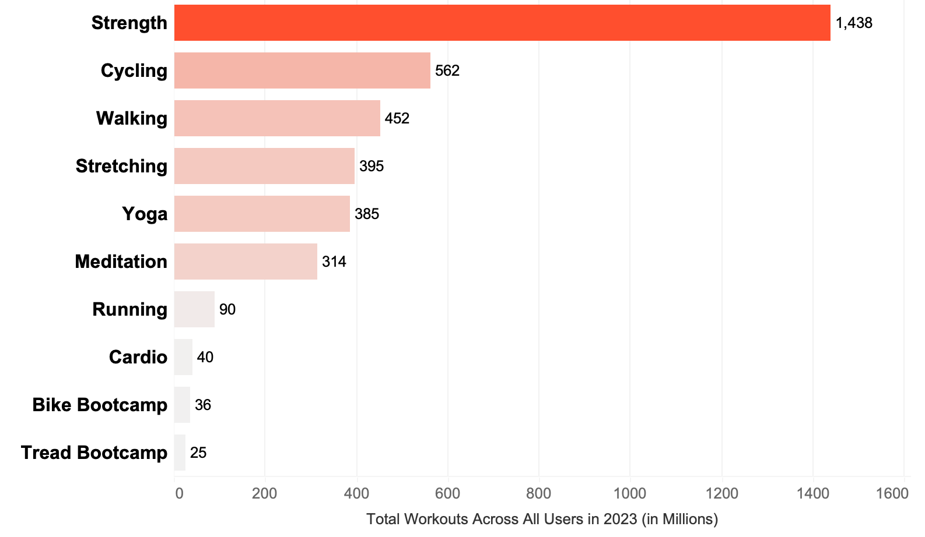
Misalignment: User Preferences vs. Peloton's Core Offerings
Peloton primarily focuses on Biking, Running, and Rowing especially in selling equipment.
Yet, strength workouts are 2.6x more popular than cycling and 16x more popular than running. Rowing doesn’t even appear in the top 10 most popular workout categories.

Slide 11
Competitive
Analysis

Slide 12
Peloton’s Mission Statement
Peloton uses technology and design to connect the world through fitness, empowering people to be the best version of themselves anywhere, anytime.
Technology
Community
Empowerment

Slide 13








Unremarkable Value Proposition
Our purpose is to empower women through fitness.
Echelon's mission is to inspire and empower people from all walks of life to achieve healthier, happier lives by providing the most affordable, approachable, and innovative live connected fitness solution.
At Zwift, our mission is to make indoor cycling more immersive, social, and accessible to cyclists around the world
Since opening our doors in 1989, our mission has been to make working out a good time.
In everything we do, we create the possibility for people to maximize the potential within themselves.
As the high-performance luxury lifestyle leader, we inspire our connected community with personalized service and unparalleled experiences
Fitness+ intelligently and seamlessly incorporates key workout metrics users love from Apple Watch directly to iPhone, iPad, and Apple TV alongside inspiring workout content for an unparalleled, highly personalized, immersive experience, set to motivating music from the world’s top artists.
Strava is Swedish for “strive,” which epitomizes our attitude and ambition: We’re a passionate and committed team, unified by our mission to build the most engaged community of athletes in the world.
Our mission is to enhance people's lives by providing a high-quality fitness experience in a welcoming, non-intimidating environment,

Slide 14




Good Fitness
Technology
Community
Empowerment

Slide 15
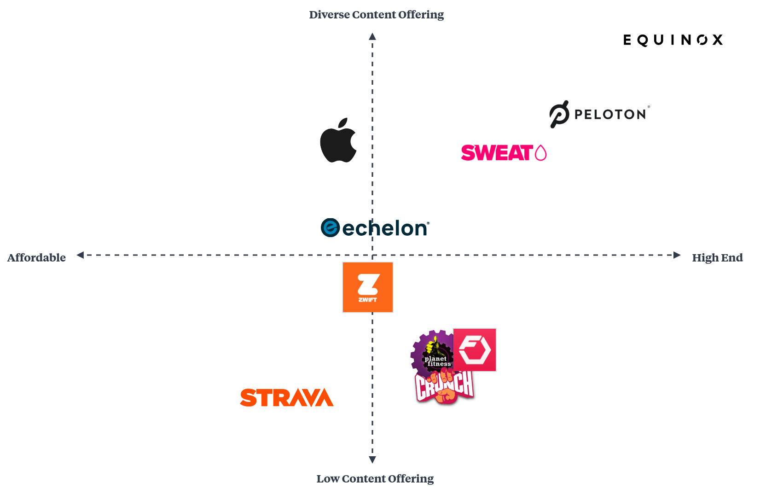
Brand Positioning: Content Variety vs. Price

Slide 16
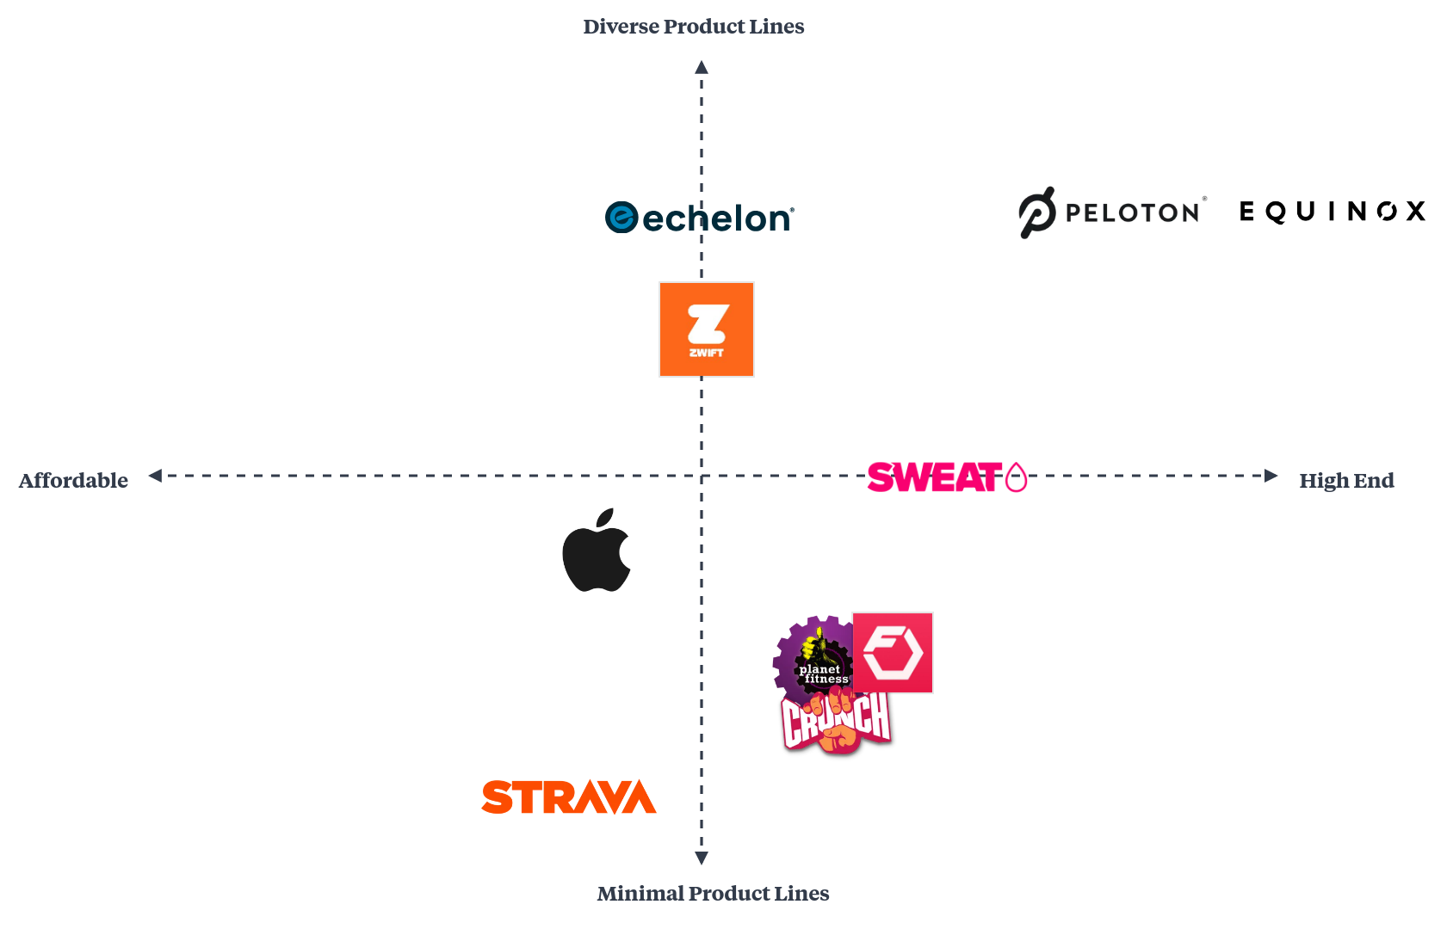
Brand Positioning: Product Line vs. Price

Slide 17
Solutions

Slide 18
Strategic Recommendations
Diversify
Expand
Innovate
Peloton’s content library with exclusive strength-based programs and hybrid workout options, such as Pilates and barre.
Marketing efforts to highlight the app-only subscription, clarifying that Peloton’s value extends beyond equipment ownership
New partnerships and acquisitions to enhance market reach and attract a broader audience

Slide 19
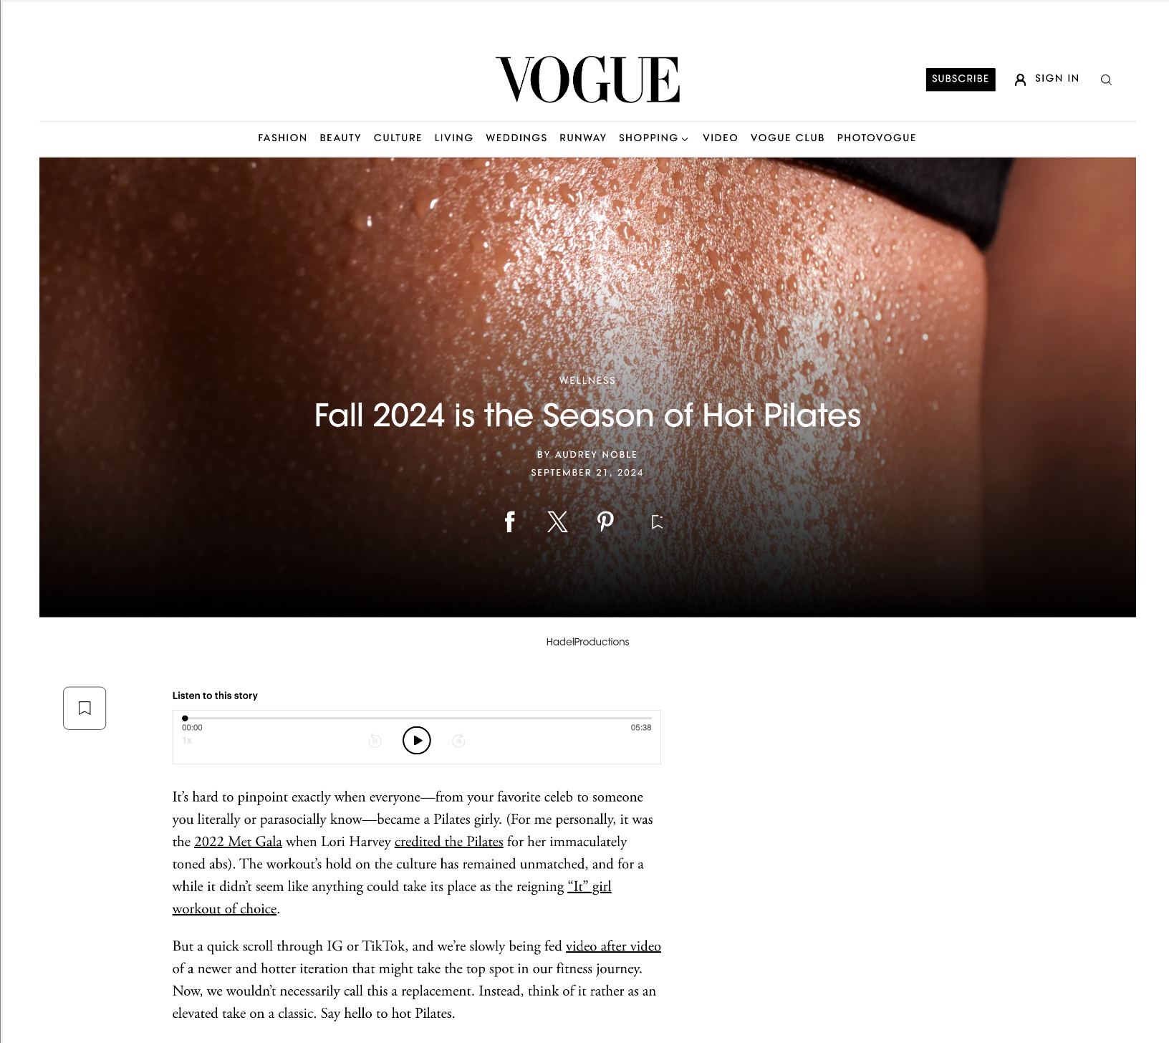
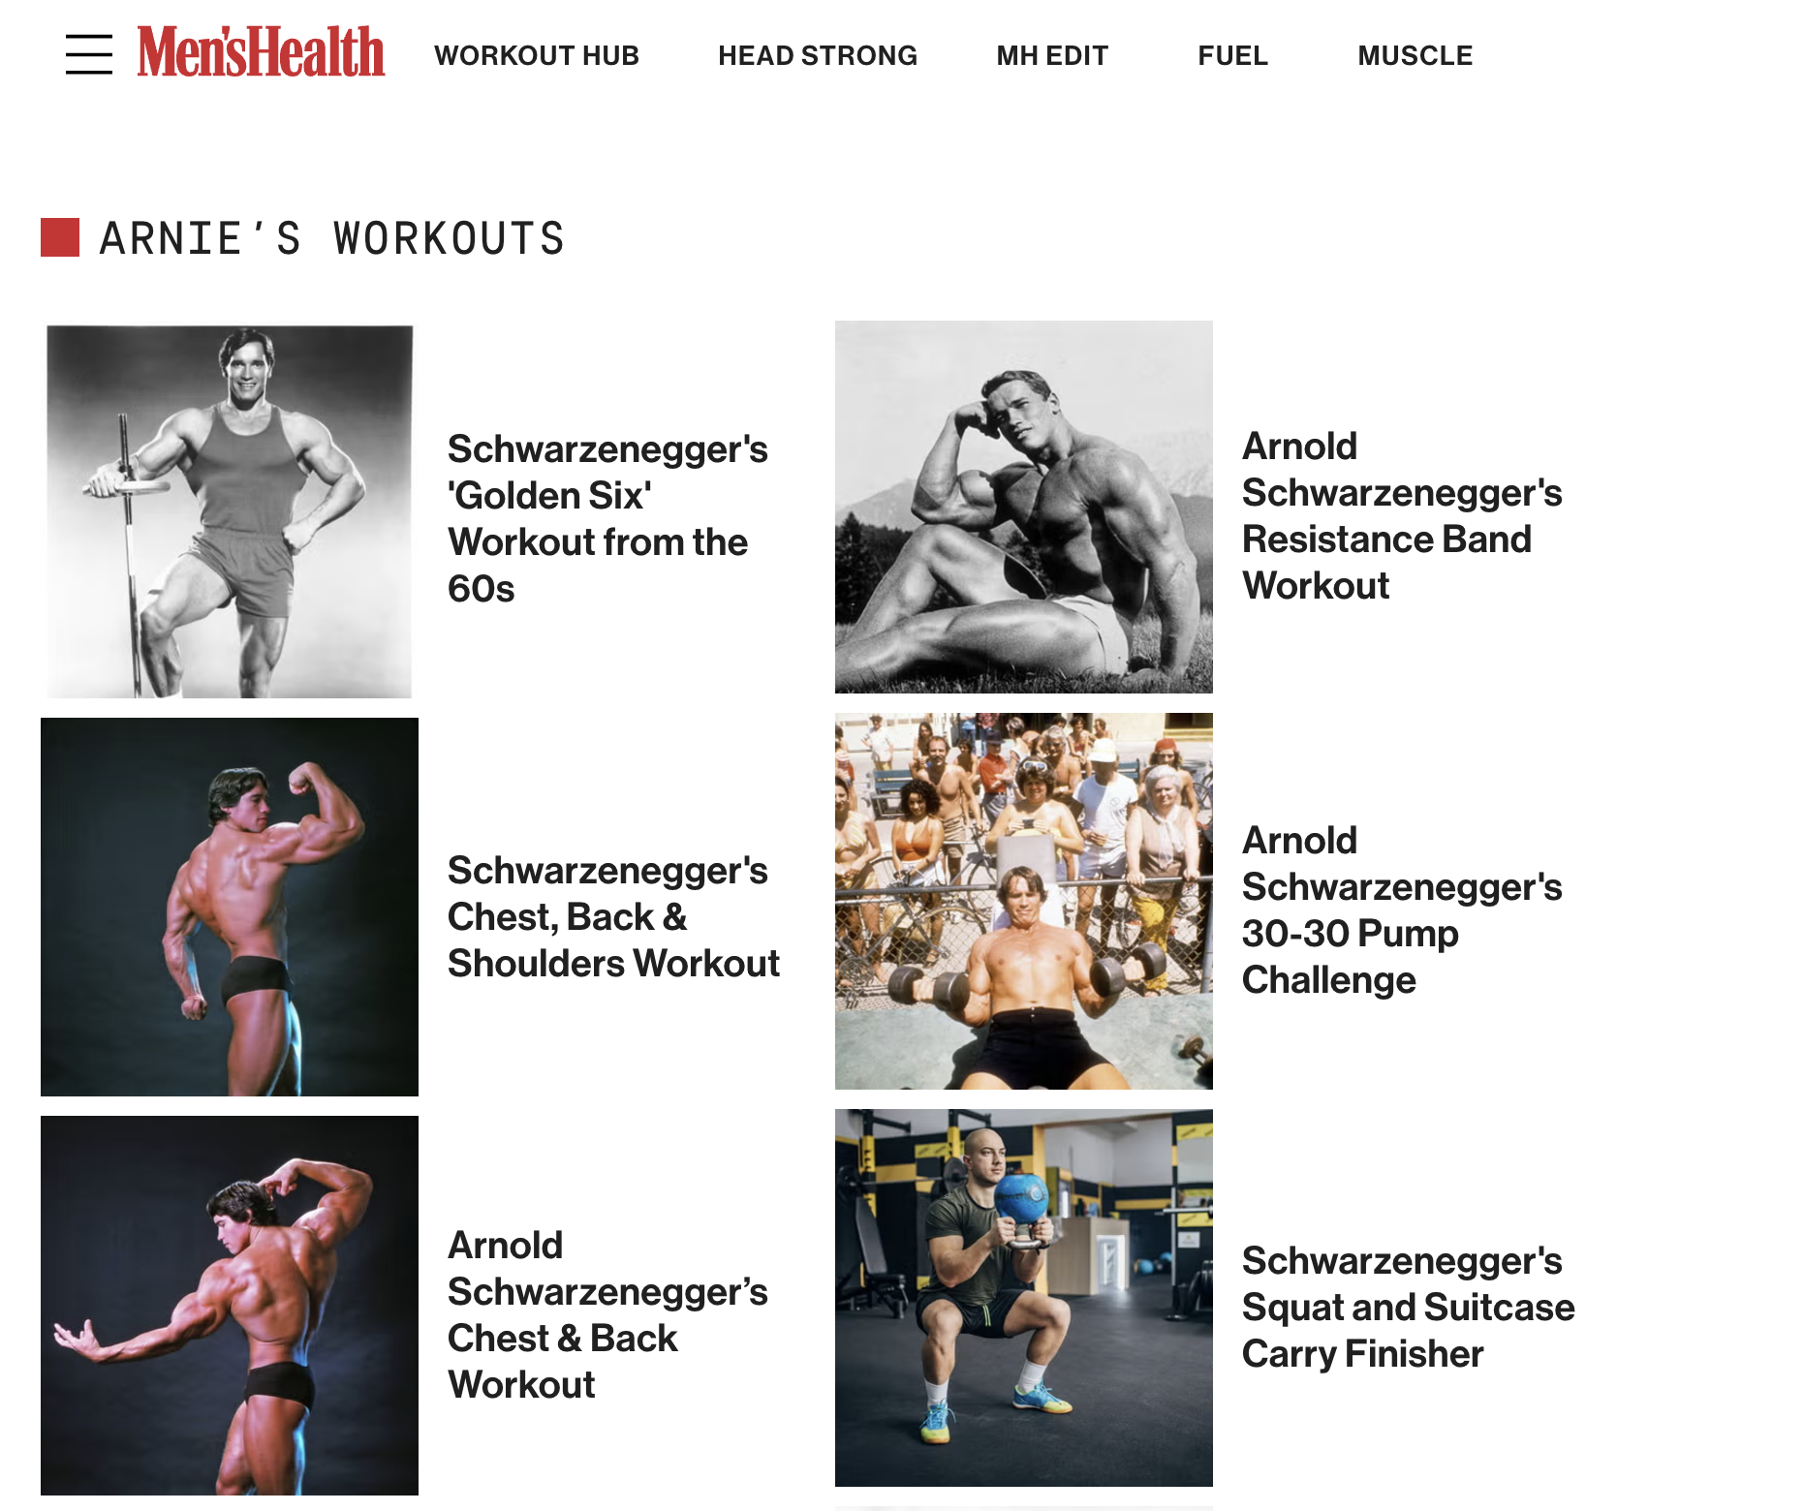

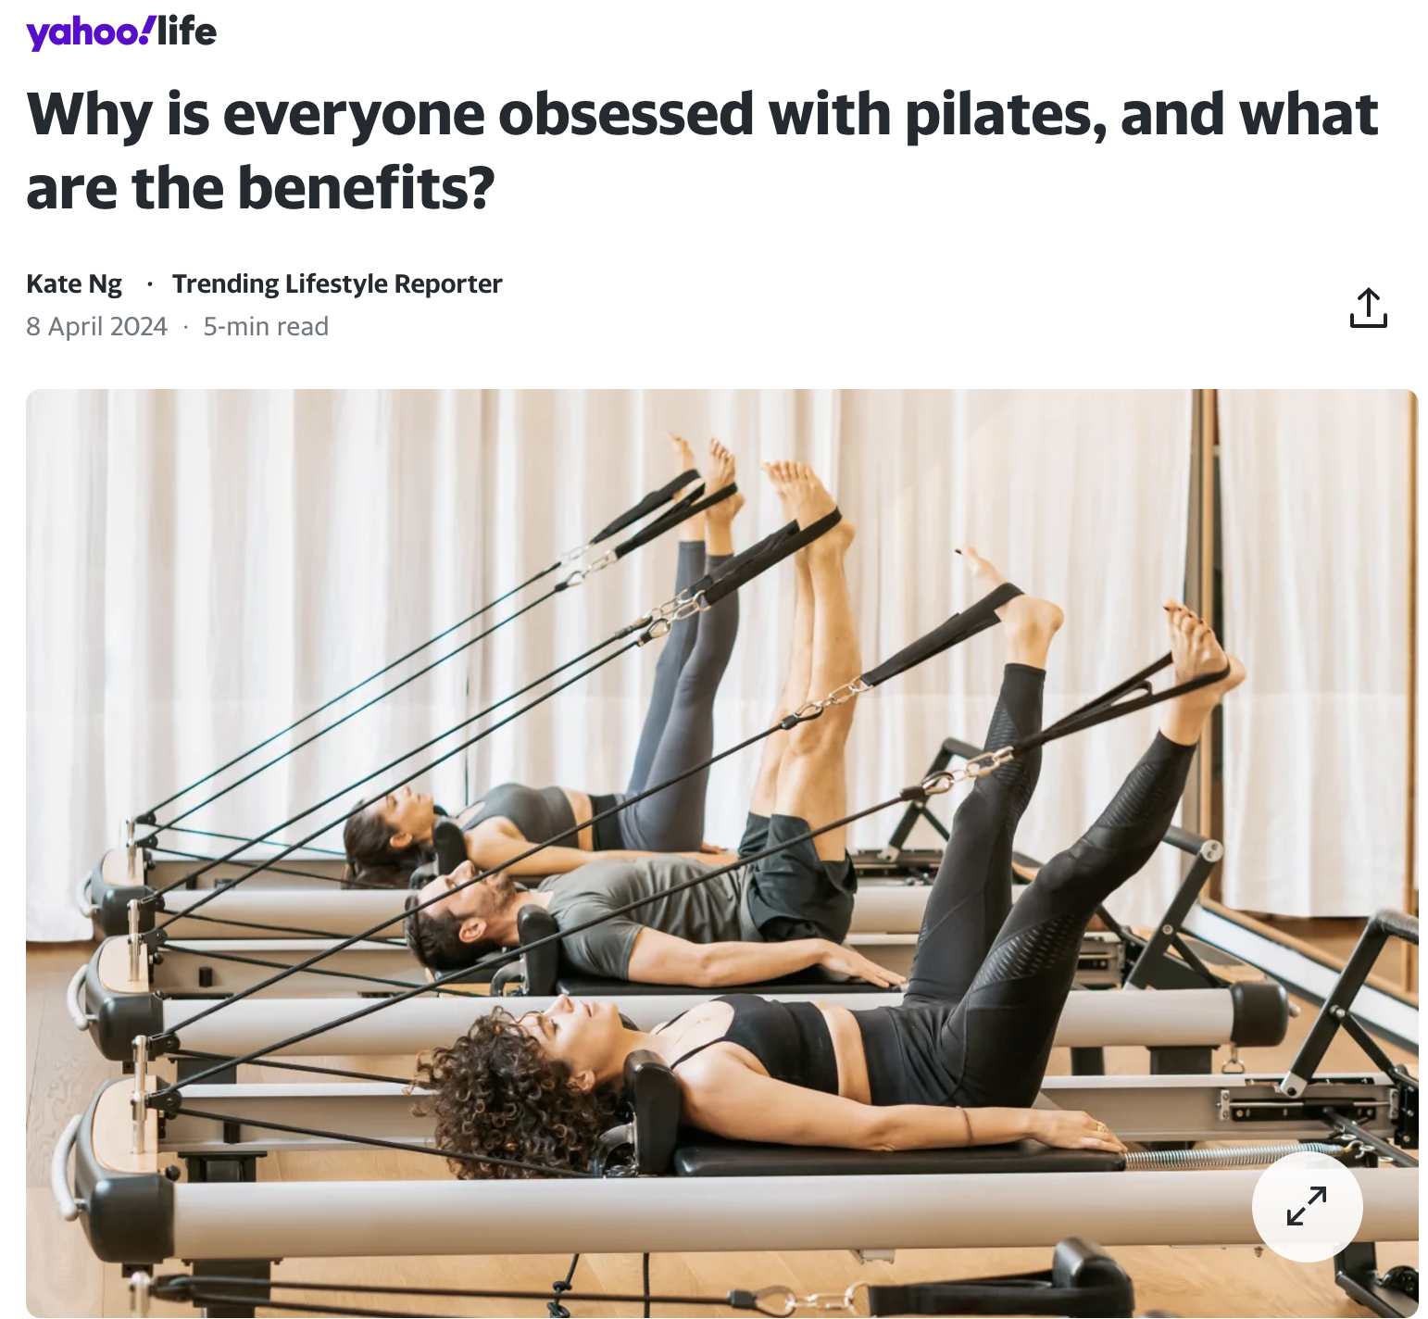
Diversify
Capitalizing on the surging pilates and other trends to bring more visibility and attract new consumers
Hybrid workout options (Pilates, barre, strength) provide variety, while maintaining Peloton’s customer’s demands

Slide 20
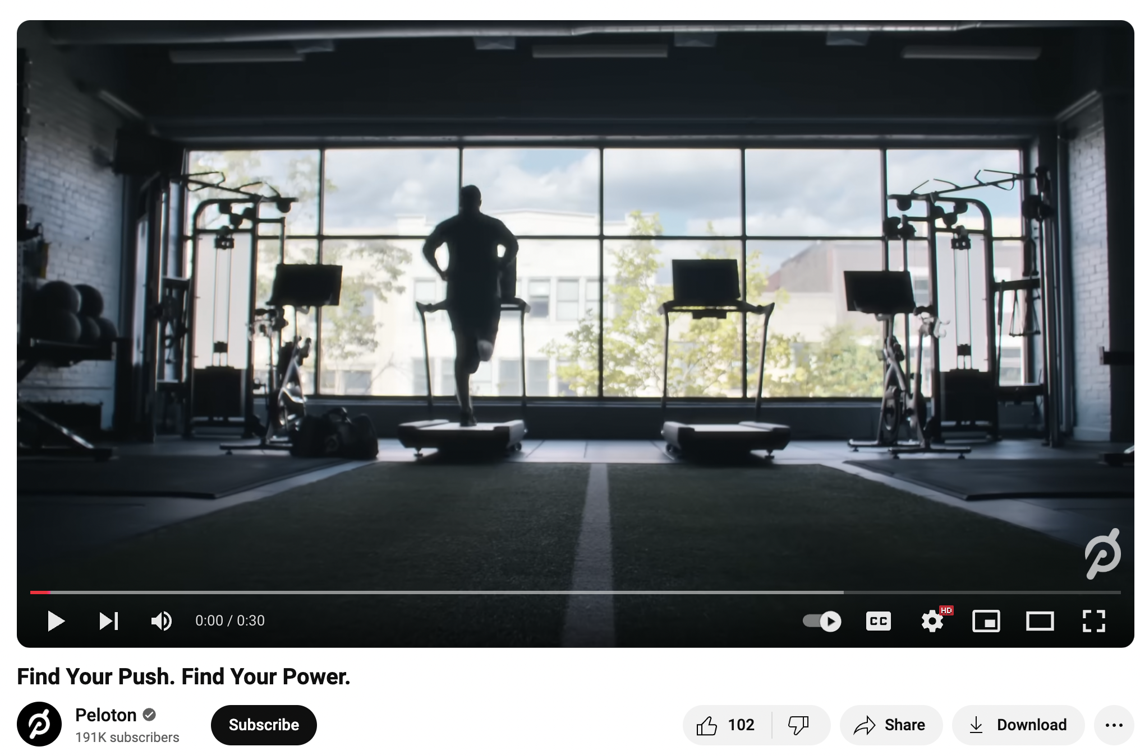
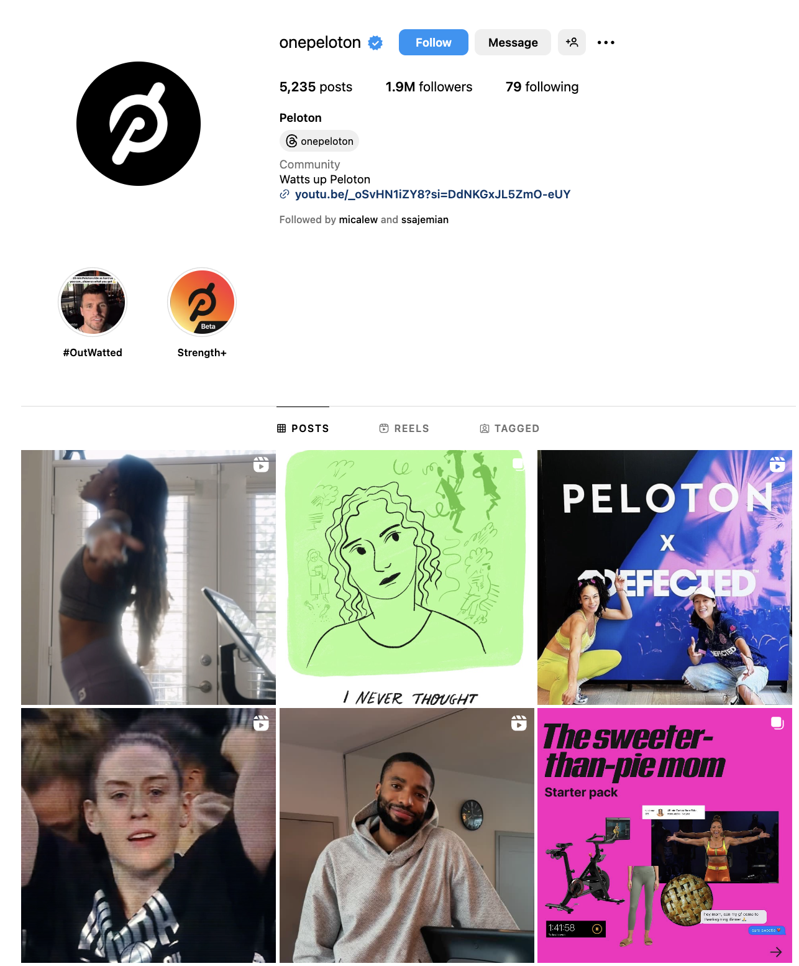
Expand
Increase marketing campaigns to keep audiences informed: Peloton is more than just bikes
Strengthen social media presence to ensure messaging stays strong
Stay relevant! Especially amidst changing landscapes (pandemic, trends)

Slide 21
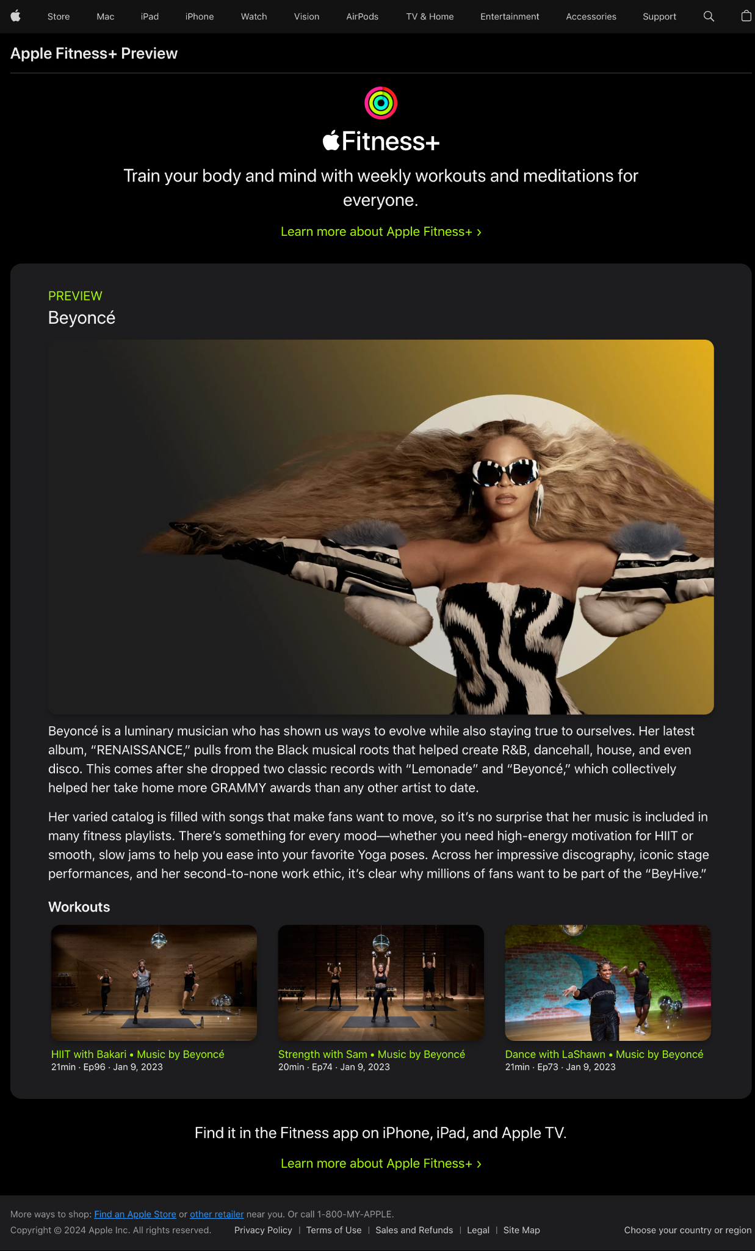
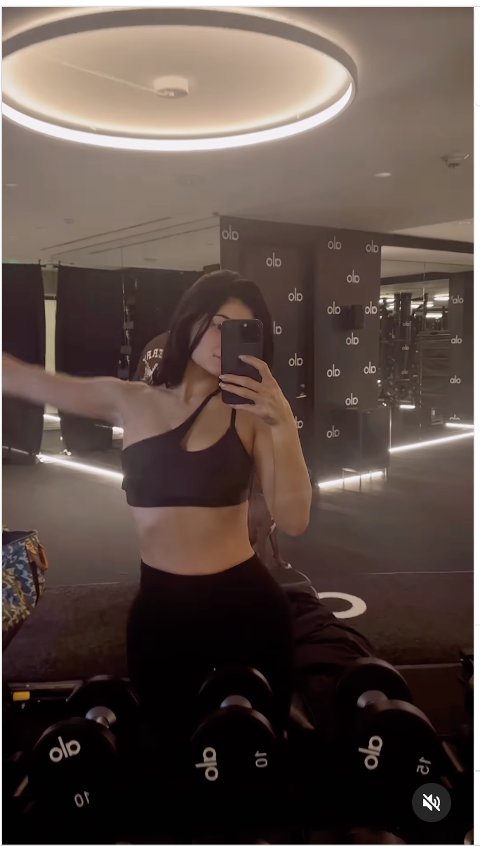
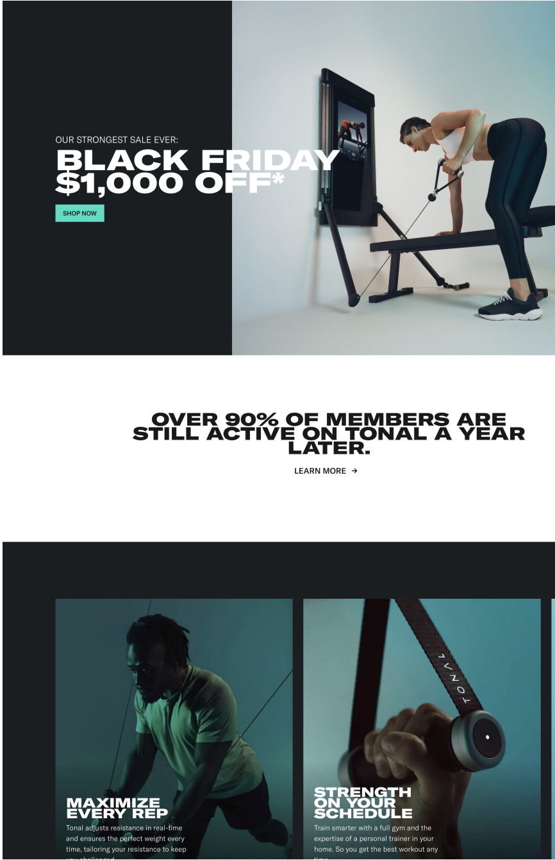
Innovate
Create innovative celebrity masterclasses to reach a broader audience
Product expansion to better target Peloton’s customer preference (ex: strength)
Other acquisitions for broader market share (ex. Tonal. Strength App)

Slide 22

We estimate a 7% increase in annual revenue and a 10% reduction in churn within the next year
Growth Drivers & Market Validation
Untapped opportunity in Strength Training
+12% YoY growth in the strength training marke (IHRSA Report 2023)
2.6x greater customer interest than cycling
Industry Success Benchmark
Lululemon achieved 11% growth after content diversification (2022 Annual Report)
Planet Fitness reduced churn by 12% when shifting its focus from cardio to strength (2018 Annual Report)

Slide 23
Together, we can reposition Peloton for sustainable success in the evolving fitness landscape
We are happy to answer any questions you may have!

